Slide 1
Life Of A CVE In Ingress-Nginx
Understanding The Project's Release Cycle
James Strong - Chainguard
Dylen Turnbull - NGINX

Slide 2

James
Solution Architect @ Chainguard
Maintainer of Kubernetes Ingress-nginx
Author Networking and Kubernetes
ACloud Guru Instructor
Gimli Cosplay Enthusiast

Slide 3

Dylen
Developer Advocate / Solutions Architect @ NGINX part of F5
Co-Host NGINX Engine Room Show
Game Development Enthusiast
Camera Operator @ ATMO Esports
Curious to see James's Dwarven Mail

Slide 4
Agenda
CVE Review
NGINX Core CVE Remediation
Ingress-NGINX Release

Slide 5
But first - Ingress-NGINX annotations
118 Annotations
apiVersion: networking.k8s.io/v1
kind: Ingress
metadata:
name: nginx-configuration-snippet
annotations:
nginx.ingress.kubernetes.io/configuration-snippet: |
more_set_headers "Request-Id: $req_id";
spec:
ingressClassName: nginx
rules:
- host: custom.configuration.com
http:
paths:
- path: /
pathType: Prefix
backend:
service:
name: http-svc
port:
number: 80
186 nginx-configuration options
Notes:
The Ingress in this example adds a custom header to Nginx configuration that only applies to that specific Ingress. If you want to add headers that apply globally to all Ingresses, please have a look at an example of specifying custom headers.

Slide 6
Ingress-NGINX Config map
118 Annotations
apiVersion: v1
kind: ConfigMap
metadata:
name: ingress-nginx-controller
namespace: ingress-nginx
labels:
app.kubernetes.io/name: ingress-nginx
app.kubernetes.io/part-of: ingress-nginx
data:
proxy-connect-timeout: "10"
proxy-read-timeout: "120"
proxy-send-timeout: "120"
186 nginx-configuration options
Notes:
Using a ConfigMap is possible to customize the NGINX configuration
For example, if we want to change the timeouts we need to create a ConfigMap

Slide 7
CVE Review

Slide 8
CVE Timeline
July - Initial HackerOne Report

Slide 9
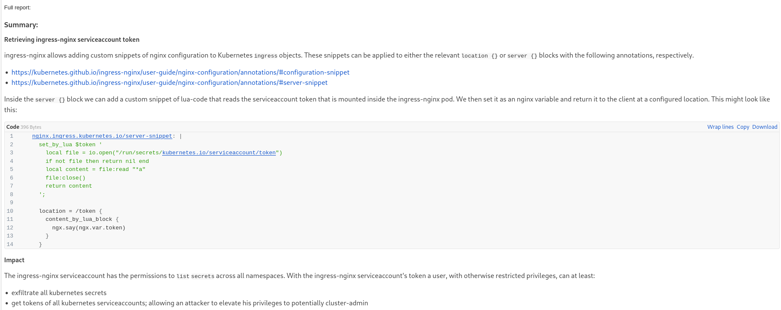
Annotation CVE Report

Slide 10
CVE Timeline
July - Initial HackerOne Report
August - Verified, reproducible vulnerability
September 15 - Maintainers were notified

Slide 11
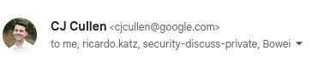
CVE Timeline

Slide 12
CVE Timeline
July - Initial HackerOne Report
August - Verified, reproducible vulnerability
September 15 - Maintainers were notified
September 17 - Ricardo PR mitigation
September 22 - v1.0.1 Release with mitigation

Slide 13
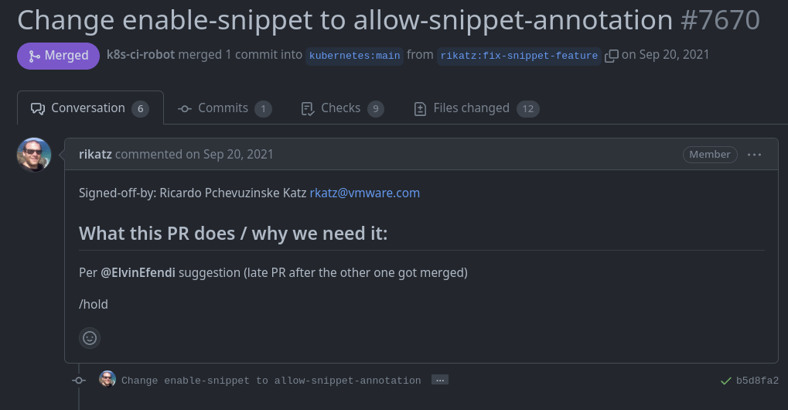
CVE Timeline

Slide 14
CVE Timeline
July - Initial HackerOne Report
August - Verified, reproducible vulnerability
September 15 - Maintainers were notified
September 17 - Ricardo PR mitigation
September 22 - v1.0.1 Release with mitigation
October 29 - NVD Release CVE-2021-25742

Slide 15

CVE Reporting
Kubernetes SRC Team
Report a Vulnerability
Ingress-NGINX Security Reporting

Slide 16

Coders gonna code
If they can run code, then they can run code
Raymond Chen
https://devblogs.microsoft.com/oldnewthing/20070706-00/?p=26123

Slide 17
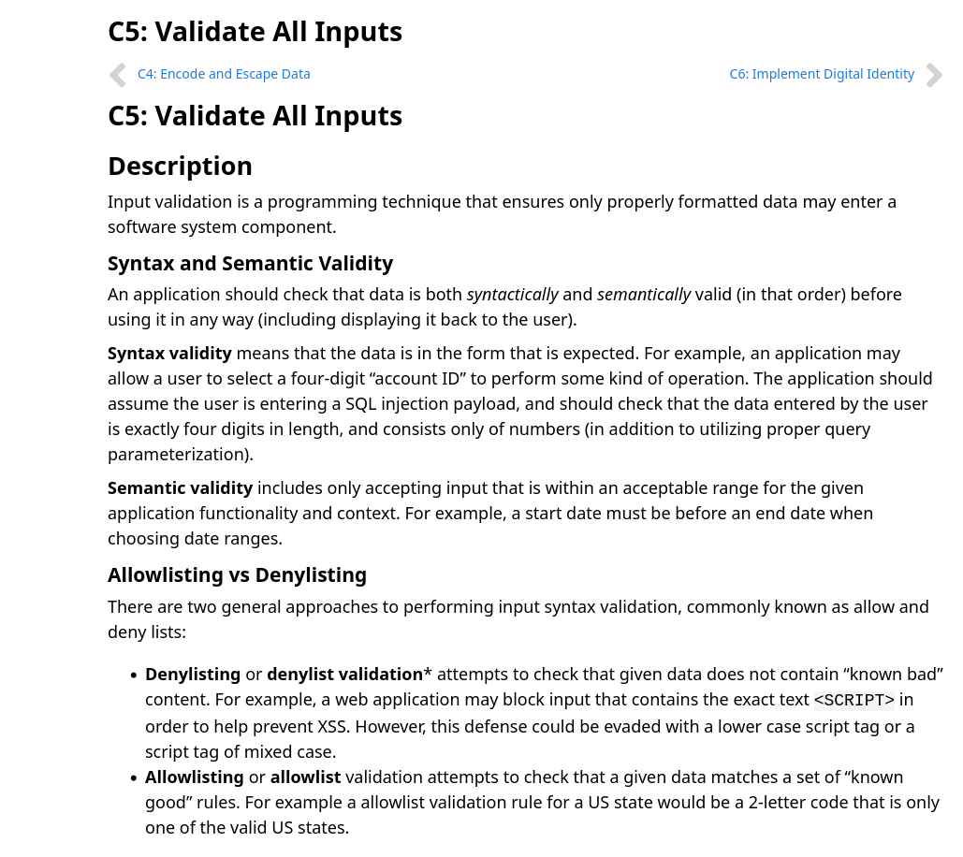
OWASP was right

Slide 18
NGINX Core CVE Remediation

Slide 19
NGINX CVE Remediation
External notification from researchers received via PGP encrypted mail to CERT
?
?
DAY 0
WEEK 2
90 DAYS
WEEK 1
30 DAYS
?
?
Notes:
DAY 0
Get external notification from researchers that find the vulnerabilities.
Researchers are often credited with the research and in some cases they will publish a paper on the research.
Accolades are afforded to those folks as well in the form of accreditation.
Send it in to CERT on the list are NGINX folks, F5 core team members and others.
Communicate with the researcher to determine the feasibility of the submission.
Some come in that are more academic in nature and only happen in very specific edge cases that in some cases are not feasible in applications reflective of mainstream environments.
Some come in that tick the boxes for main steam feasibility and are deemed actual threats that need to be addressed.

Slide 20
NGINX CVE Remediation
External notification from researchers received via CERT submission
?
?
DAY 0
WEEK 2
90 DAYS
WEEK 1
30 DAYS
Submission qualifies for main steam feasibility and is deemed an actual threat
?
Notes:
WEEK 1
Once the vulnerability reaches this state the team of contributors is expanded and discussion and debate on the topic takes place.
This can last around a month of engineering discussion and development work.
During this discussion they explore a myriad of topics the first being what are the differing threat vectors through which this vulnerability can be exploited.
In some instances the definition of the CVE can expand and in some cases split into multiple CVE’s depending on the outcome of the discussion.

Slide 21
NGINX CVE Remediation
External notification from researchers received via CERT submission
The next step is to create the bits for remediation of the vulnerability
?
DAY 0
WEEK 2
90 DAYS
WEEK 1
30 DAYS
Submission qualifies for main steam feasibility and is deemed an actual threat
?
Notes:
WEEK 2
The next step is to create the bits for remediation of the vulnerability that generally comes in the form of a patch.
Mitigation strategies that may exist are often included in communication.

Slide 22
NGINX CVE Remediation
External notification from researchers received via CERT submission
The next step is to create the bits for remediation of the vulnerability
?
DAY 0
WEEK 2
90 DAYS
WEEK 1
30 DAYS
Submission qualifies for main steam feasibility and is deemed an actual threat
Once the bits/patch is complete the general timeframe for release is around two weeks.
Notes:
30 DAYS (Release)
Once the bits/patch is complete the general timeframe for release is around two weeks.
The researcher is notified that disclosure of the CVE is eminent

Slide 23
NGINX CVE Remediation
External notification from researchers received via CERT submission
The next step is to create the bits for remediation of the vulnerability
Industry standard for time frames is around 90 days, often shorter
DAY 0
WEEK 2
WEEK 2
WEEK 1
30 DAYS
Submission qualifies for main steam feasibility and is deemed an actual threat
Once the bits/patch is complete the general timeframe for release is around two weeks.
Notes:
90 Days
Industry standard for time frames is around 90 days, often shorter. This is not a written standard but in general it is the accepted time frame for work prior to disclosure.

Slide 24
NGINX CVE Remediation
External notification from researchers received via CERT submission
The next step is to create the bits for remediation of the vulnerability
Industry standard for time frames is around 90 days, often shorter
DAY 0
WEEK 2
WEEK 2
Community
WEEK 1
30 DAYS
This way
Submission qualifies for main steam feasibility and is deemed an actual threat
Once the bits/patch is complete the general timeframe for release is around two weeks.
Notes:
Post Release
This is often when community is able to begin work on CVEs that do not come through them directly

Slide 25
Ingress-NGINX Release Process

Slide 26

Ingress-NGINX Release
Update Tag
GitHub PR
GitHub PR
Git Tag
GitHub PR
k8s.io
Helm changelog
GitHub Release
GCP Cloud Build
Helm Chart Version Update
Helm Chart Controller Version update
make release
Changelog Update
Container Image
Documentation Update

Slide 27

Ingress-NGINX Release
Update Tag
GitHub PR
GitHub PR
Git Tag
GitHub PR
k8s.io
Helm changelog
GitHub Release
GCP Cloud Build
Helm Chart Version Update
Helm Chart Controller Version update
make release
Changelog Update
Container Image
Documentation Update

Slide 28

Ingress-NGINX Release
Update Tag
GitHub PR
GitHub PR
Git Tag
GitHub PR
k8s.io
Helm changelog
GitHub Release
GCP Cloud Build
Helm Chart Version Update
Helm Chart Controller Version update
make release
Changelog Update
Container Image
Documentation Update

Slide 29

Ingress-NGINX Release
Update Tag
GitHub PR
GitHub PR
Git Tag
GitHub PR
k8s.io
Helm changelog
GitHub Release
GCP Cloud Build
Helm Chart Version Update
Helm Chart Controller Version update
make release
Changelog Update
Container Image
Documentation Update

Slide 30
Ingress-NGINX Complexity
Golang, Alpine, Nginx, Lua
43 Deps compiled across 4 architectures for 3 Kubernetes versions, for helm and other deployments
1 Kubectl plugin
2 Monitoring frameworks
3 Third Party plugins
68 Ingress-nginx Command line Flags
4 hour build time
7 static configurations
118 Annotations
12 other container images
186 nginx-configuration options
30 NGINX modules
400+ e2e tests

Slide 31

Thank you!
Ingress-Nginx Dev Slack Channel
Ingress-Nginx User Support Slack Channel
New Contributor Docs
Community Meetings + Notes
Every Other Thursday @ 11 et
Community Meetings Youtube Playlist

Slide 32


